Slide 1

Design Around
Recent Developments in Design Patent Law
PRESENTED BY
Nika Aldrich
Experience what we know about
your industry and what it’s like to
be represented by Schwabe.
April 2, 2025

Slide 2

35 U.S.C. § 171(a)
“Whoever invents any new, original and ornamental design for an article of manufacture may obtain a patent therefore, subject to the conditions and requirements of this title.”

Slide 3
35 U.S.C. § 171(b)
“The provisions of this title relating to patents for inventions shall apply to patents for designs, except as otherwise provided.”

Slide 4
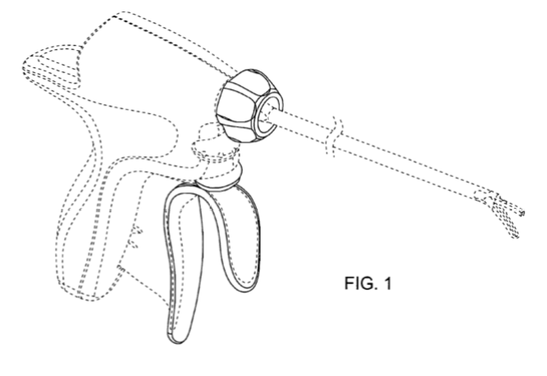
Ethicon Endo-Surgery, Inc. v. Covidien, Inc., 796 F.3d 1312 (Fed. Cir. 2015)
Notes:
We agree that the trigger, torque knob, and activation button elements of the underlying article have functional aspects. But the district court's construction of the Design Patents to have no scope whatsoever fails to account for the particular ornamentation of the claimed design and departs from our established legal framework for interpreting design patent claims.
[F]or purposes of claim construction, the district court ignored the facts that the trigger has a particular curved design, the torque knob has a particular flat-front shape, and the activation button has a particular rounded appearance. Unlike the functionality inherent in the underlying articles themselves, there is no evidence in the record, that any of the ornamental designs adorning those underlying articles are essential to the use of the article. . . . Thus, although the Design Patents do not protect the general design concept of an open trigger, torque knob, and activation button in a particular configuration, they nevertheless have some scope—the particular ornamental designs of those underlying elements.

Slide 5


Obviousness

Slide 6
Durling v. Spectrum Furniture Co., Inc.,
101 F.3d 100 (Fed. Cir. 1996)
“In the design patent context, the ultimate inquiry under section 103 is whether the claimed design would have been obvious to a designer of ordinary skill who designs articles of the type involved. In re Rosen, 673 F.2d 388, 390, 213 USPQ 347, 349 (C.C.P.A. 1982). More specifically, the inquiry is whether one of ordinary skill would have combined teachings of the prior art to create the same overall visual appearance as the claimed design.”

Slide 7
In re Rosen, 673 F.2d 388, 391 (C.C.P.A. 1982) (quoting In re Jennings, 182 F.2d 207, 208 (C.C.P.A. 1960)
“In considering patentability of a proposed design the appearance of the design must be viewed as a whole, as shown by the drawing, or drawings, and compared with something in existence — not with something that might be brought into existence by selecting individual features from prior art and combining them, particularly where combining them would require modification of every individual feature.”
Notes:
Patent application claimed a table. Prior art were desks. “The modifications of [the primary reference desk] necessary to achieve appelant’s table design would destroy fundamental characteristics of the [desk] design. . . . The board’s reliance upon obviousness of construction, apropos of a mechanical patent, ignores the need for an adequate starting point, a basic reference which embodies similar design concepts.”

Slide 8
Durling v. Spectrum Furniture Co., Inc.,
101 F.3d 100 (Fed. Cir. 1996)
“Before one can begin to combine prior art designs, however, one must find a single reference, a something in existence, the design characteristics of which are basically the same as the claimed design. In re Rosen, 673 F.2d at 391, 213 USPQ at 350. Once this primary reference is found, other references may be used to modify it to create a design that has the same overall visual appearance as the claimed design. . . . These secondary references may only be used to modify the primary reference if they are so related to the primary reference that the appearance of certain ornamental features in one would suggest the application of those features to the other."

Slide 9
KSR Intern. Co., v. Teleflex, Inc.,
550 U.S. 398 (2007)
“[t]he obviousness analysis cannot be confined by a formalistic conception of the words teaching, suggestion, and motivation . . . .”

Slide 10
LKQ Corp. v. GM Global Tech. Operations LLC, 102 F.4th 1280 (Fed. Cir. 2024)
“We conclude that the Rosen-Durling test requirements —that (1) the primary reference be "basically the same" as the challenged design claim; and (2) any secondary references be ‘so related’ to the primary reference that features in one would suggest application of those features to the other—are improperly rigid.”
Notes:
Nonprecedential

Slide 11
LKQ Corp. v. GM Global Tech. Operations LLC, 102 F.4th 1280 (Fed. Cir. 2024)
“Having overruled Rosen and Durling, we consider what the framework for evaluating obviousness of design patent claims should be.”
Notes:
Nonprecedential

Slide 12
LKQ Corp. v. GM Global Tech. Operations LLC, 102 F.4th 1280 (Fed. Cir. 2024)
1.
“Applying Graham factor one, the fact finder should consider the ‘scope and content of the prior art’ within the knowledge of an ordinary designer in the field of the design. . . . We reaffirm that an analogous art requirement applies for obviousness of design patents.”
Notes:
Nonprecedential

Slide 13
LKQ Corp. v. GM Global Tech. Operations LLC, 102 F.4th 1280 (Fed. Cir. 2024)
“For utility patents, we use a two-part test to determine the scope of analogous art: (1) whether the art is from the same field of endeavor as the claimed invention; and (2) if the reference is not within the field of the inventor's endeavor, whether the reference still is reasonably pertinent to the particular problem with which the inventor is involved.”
Notes:
Nonprecedential

Slide 14
LKQ Corp. v. GM Global Tech. Operations LLC, 102 F.4th 1280 (Fed. Cir. 2024)
“We conclude that the first part of this two-part test applies to design patents in a straightforward manner.”
Notes:
Nonprecedential

Slide 15
LKQ Corp. v. GM Global Tech. Operations LLC, 102 F.4th 1280 (Fed. Cir. 2024)
“On the other hand, the second part of the two-part analogous art test for utility patents would not seem to apply to design patents in the same way, and how to translate this part of the test into the design context is less apparent. Unlike a utility patent, a design patent itself does not clearly or reliably indicate ‘the particular problem with which the inventor is involved.’”
Notes:
Nonprecedential

Slide 16
LKQ Corp. v. GM Global Tech. Operations LLC, 102 F.4th 1280 (Fed. Cir. 2024)
“In this opinion, we do not delineate the full and precise contours of the analogous art test for design patents. Prior art designs for the same field of endeavor as the article of manufacture will be analogous, and we do not foreclose that other art could also be analogous. . . . [W]e ‘leave it to future cases to further develop the application of this standard.’”
Notes:
Nonprecedential

Slide 17
LKQ Corp. v. GM Global Tech. Operations LLC, 102 F.4th 1280 (Fed. Cir. 2024)
2.
“[I]n addressing the differences between the claimed design and prior art designs for validity purposes, we compare the visual appearance of the claimed design with prior art designs, albeit from the perspective of an ordinary designer in the field of the article of manufacture.”
Notes:
Nonprecedential

Slide 18
LKQ Corp. v. GM Global Tech. Operations LLC, 102 F.4th 1280 (Fed. Cir. 2024)
3.
“[F]or Graham factor three, we consider the knowledge of ‘a designer of ordinary skill who designs articles of the type involved.’”
Notes:
Nonprecedential

Slide 19
LKQ Corp. v. GM Global Tech. Operations LLC, 102 F.4th 1280 (Fed. Cir. 2024)
4.
“[T]here must be some record-supported reason (without hindsight) that an ordinary designer in the field of the article of manufacture would have modified the primary reference with the feature(s) from the secondary reference(s) to create the same overall appearance as the claimed design.”
Notes:
Nonprecedential

Slide 20
LKQ Corp. v. GM Global Tech. Operations LLC, 102 F.4th 1280 (Fed. Cir. 2024)
5.
“[A]assessment of secondary considerations as indicia of obviousness or nonobviousness, when evidence of such considerations is presented. In prior cases involving design patents, we have confirmed that commercial success, industry praise, and copying may demonstrate nonobviousness of design patents. . . . We leave to future cases the determination of whether considerations such as long felt but unsolved need and failure of others will have significance to the obviousness inquiry in the design patent context.”
Notes:
Nonprecedential

Slide 21
Damages

Slide 22
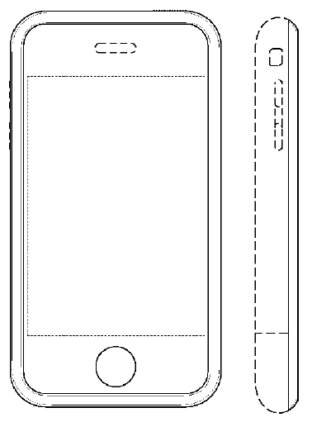
Samsung Elecs. Co. v. Apple Inc.,
580 U.S. 53 (2016)
U.S. Patent No. D593,087:
“The ornamental design of an electronic device, substantially as shown and described.”

Slide 23
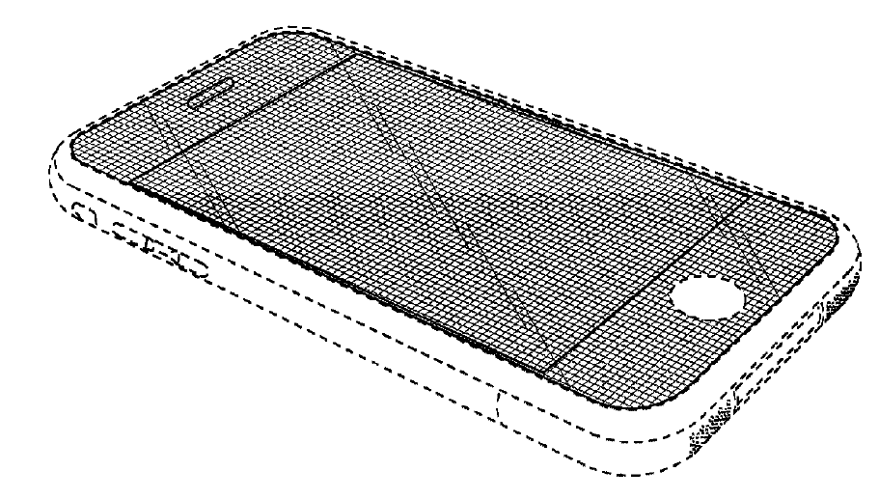
Samsung Elecs. Co. v. Apple Inc.,
580 U.S. 53 (2016)
U.S. Patent No. D618,677
“The ornamental design of an electronic device, as shown and described.”

Slide 24
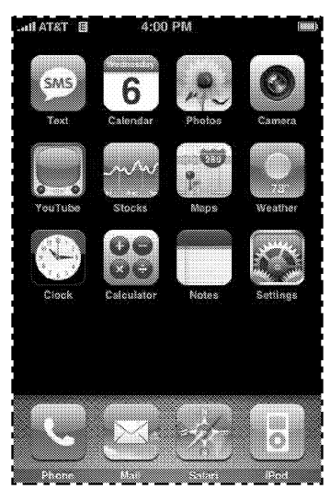
Samsung Elecs. Co. v. Apple Inc.,
580 U.S. 53 (2016)
U.S. Patent No. D604,305:
“The ornamental design for a graphical user interface for a display screen or portion thereof, as shown and described.”

Slide 25
Samsung Elecs. Co. v. Apple Inc.,
580 U.S. 53 (2016)
“Whoever during the term of a patent for a design . . . applies the patented design, or any colorable imitation thereof, to any article of manufacture for the purpose of sale, . . . shall be liable to the owner to the extent of his total profit . . .”
35 U.S.C. § 289

Slide 26
Apple Inc. v. Samsung Elecs. Co., Ltd.,
786 F.3d 983 (Fed. Cir. 2015)
Apple awarded $929,860,041 in damages based on disgorgement of Samsung’s phones.
Samsung appealed the lack of apportionment.
Samsung: profits should be awarded to “the portion of the product as sold that incorporates or embodies the subject matter of the patent.”
Federal Circuit affirmed that no apportionment was required.
“The innards of Samsung’s smartphones were not sold separately from their shells as distinct articles of manufacture to ordinary purchasers.”

Slide 27
Samsung Elecs. Co. v. Apple Inc.,
580 U.S. 53 (2016)
“Arriving at a damages award under § 289 thus involves two steps. First, identify the ‘article of manufacture’ to which the infringed design has been applied. Second, calculate the infringer’s total profit made on that article of manufacture.”
Id. at 60.

Slide 28
Samsung Elecs. Co. v. Apple Inc.,
580 U.S. 53 (2016)
“[T]he term ‘article of manufacture’ is broad enough to encompass both a product sold to a consumer as well as a component of that product. A component of a product, no less than the product itself, is a thing made by hand or machine.”
Id. at 60.

Slide 29
Article of
Manufacture

Slide 30
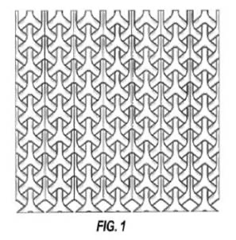
Curver Luxembourg, SARL v. Home Expressions, Inc.,
938 F.3d 1334 (Fed. Cir. 2019)
U.S. Design Patent No. D677,946:
The ornamental design for a pattern for a chair, as shown and described.
No article of manufacture shown.

Slide 31
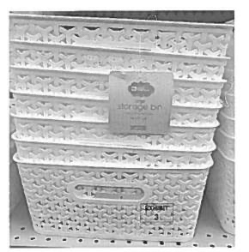
Curver Luxembourg, SARL v. Home Expressions, Inc.,
938 F.3d 1334 (Fed. Cir. 2019)

Slide 32
Curver Luxembourg, SARL v. Home Expressions, Inc., 938 F.3d 1334 (Fed. Cir. 2019)
“[C]laim language can limit the scope of a design patent where the claim language supplies the only instance of an article of manufacture that appears nowhere in the figures.”

Slide 33
Curver Luxembourg, SARL v. Home Expressions, Inc., 938 F.3d 1334 (Fed. Cir. 2019)
“The claim is not directed to a design per se, but a design for an identified article.”

Slide 34
Curver Luxembourg, SARL v. Home Expressions, Inc., 938 F.3d 1334 (Fed. Cir. 2019)
“[T]ying the design pattern to a particular article provides more accurate and predictable notice about what is and is not protected by the design patent.”

Slide 35
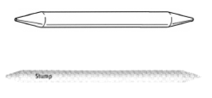
In re SurgiSil, L.L.P.
14 F.4th 1380 (Fed. Cir. 2021)
“Ornamental design for a lip implant as shown and described.”

Slide 36
In re SurgiSil, L.L.P.
14 F.4th 1380 (Fed. Cir. 2021)

Slide 37
In re SurgiSil, L.L.P.
14 F.4th 1380 (Fed. Cir. 2021)
“A design claim is limited to the article of manufacture identified in the claim; it does not broadly cover a design in the abstract. . . . Consistent with this authority, the Patent Office’s examination guidelines state that a ‘[d]esign is inseparable from the article to which it is applied and cannot exist alone . . . .’”

Slide 38
In re SurgiSil, L.L.P.
14 F.4th 1380 (Fed. Cir. 2021)
“Here, the claim identifies a lip implant. . . There is no dispute that Blick discloses an art tool rather than a lip implant. The Board’s anticipation finding therefore rests on an erroneous interpretation of the claim’s scope.”

Slide 39
Comparison
Prior Art

Slide 40
Egyptian Goddess, Inc. v. Swisa, Inc., 543 F.3d 665, 676 (Fed. Cir. 2008) (en banc).
“Particularly in close cases, it can be difficult to answer the question whether one thing is like another without being given a frame of reference. The context in which the claimed and accused designs are compared, i.e., the background prior art, provides such a frame of reference and is therefore often useful in the process of comparison. Where the frame of reference consists of numerous similar prior art designs, those designs can highlight the distinctions between the claimed design and the accused design as viewed by the ordinary observer.”

Slide 41
Wilson Sporting Goods Co. v. David Geoffrey & Assoc., 904 F.2d 677 (Fed. Cir. 1990)
“Whether prior art restricts the range of equivalents of what is literally claimed can be a difficult question to answer. To simplify analysis and bring the issue onto familiar turf, it may be helpful to conceptualize the limitation on the scope of equivalents by visualizing a hypothetical patent claim, sufficient in scope to literally cover the accused product. The pertinent question then becomes whether that hypothetical claim could have been allowed by the PTO over the prior art. . . . If the hypothetical claim could have been allowed, then prior art is not a bar to infringement under the doctrine of equivalents.”

Slide 42
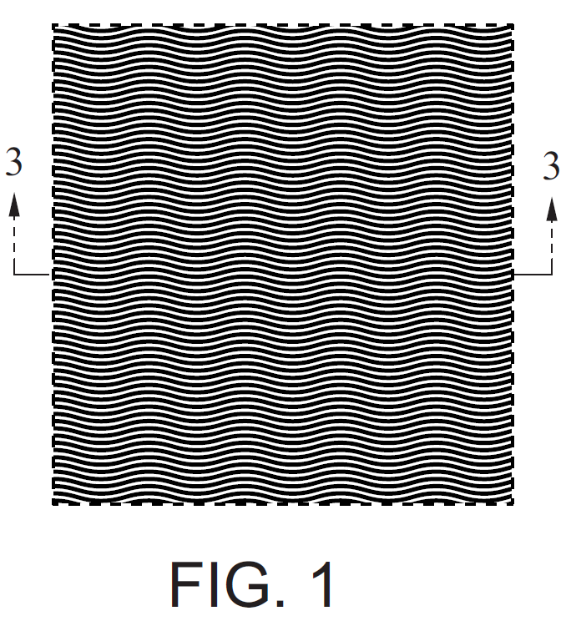
Columbia Sportswear N. Am., Inc. v. Seirus Innovative Access., Inc., 942 F.3d 1119 (Fed. Cir. 2019)
“The ornamental design of a heat reflective material, as shown and described.”

Slide 43
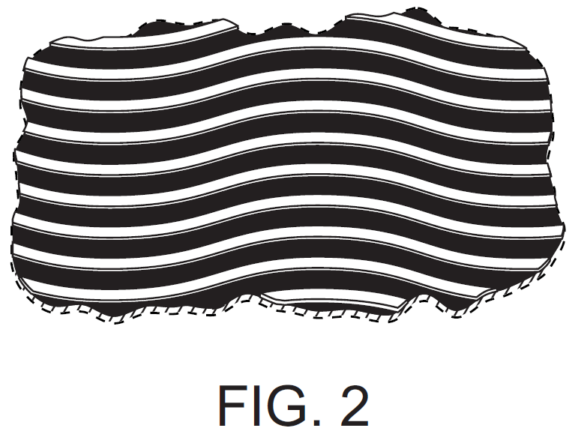
Columbia Sportswear N. Am., Inc. v. Seirus Innovative Access., Inc., 942 F.3d 1119 (Fed. Cir. 2019)

Slide 44
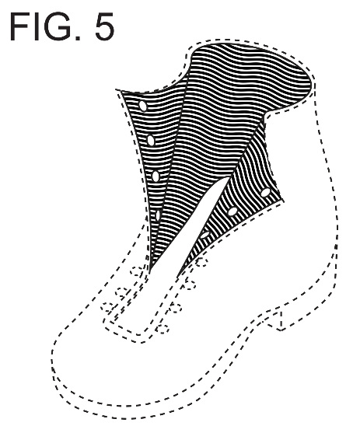
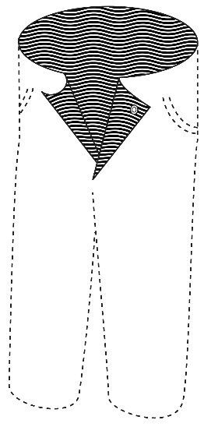

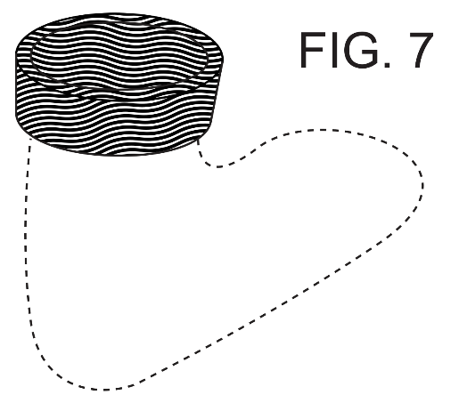
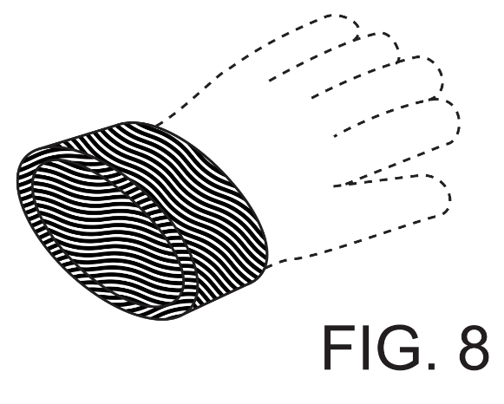
PDX 309

Slide 45
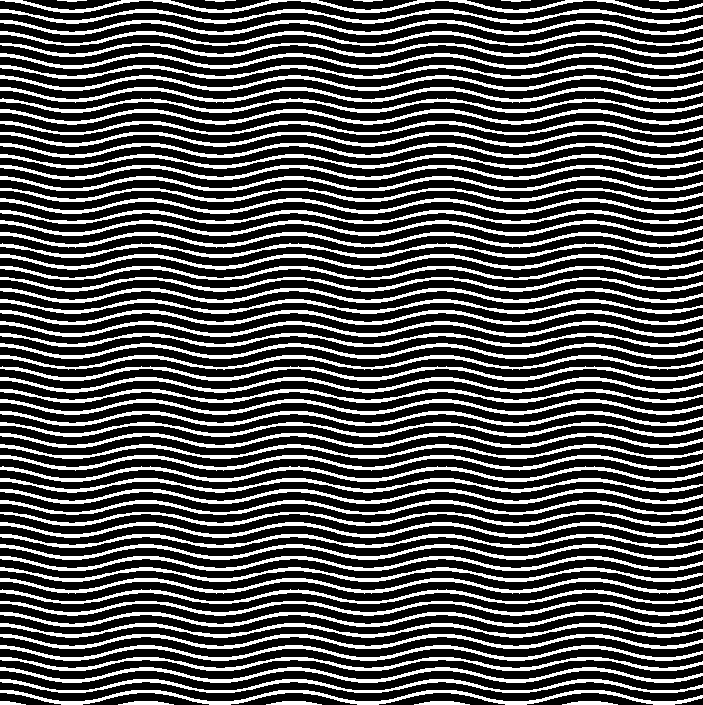
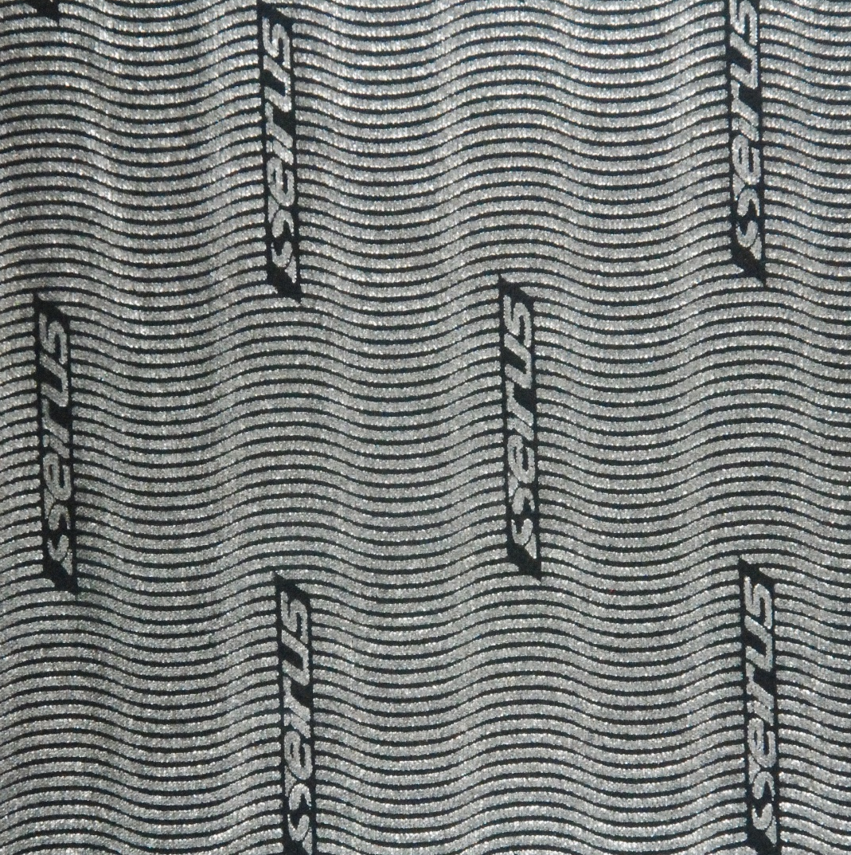
Columbia’s patented design
Seirus’s design
PDX 327

Slide 46
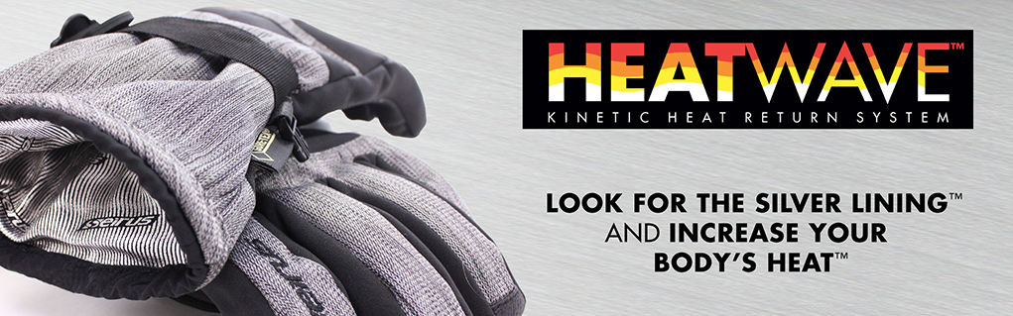
PDX 321

Slide 47
Columbia Sportswear N. Am., Inc. v. Seirus Innovative Access., Inc., 942 F.3d 1119 (Fed. Cir. 2019)
Seirus stipulated to validity.
Columbia moved for summary judgment of infringement.
Seirus introduced “comparison prior art” for purposes of establishing noninfringement.

Slide 48
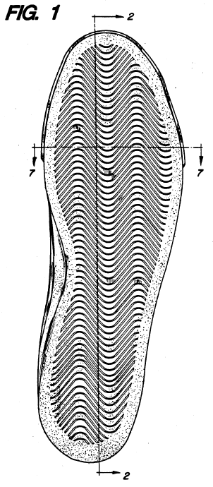
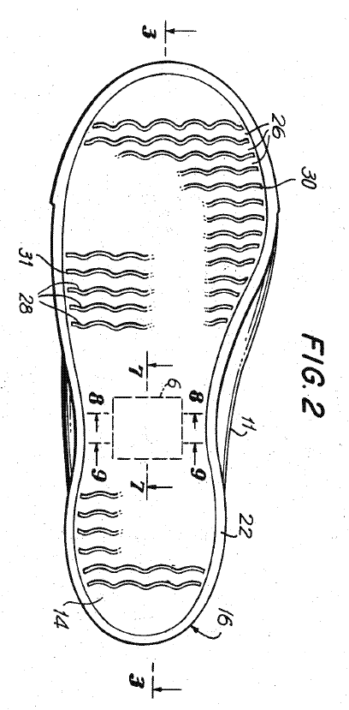
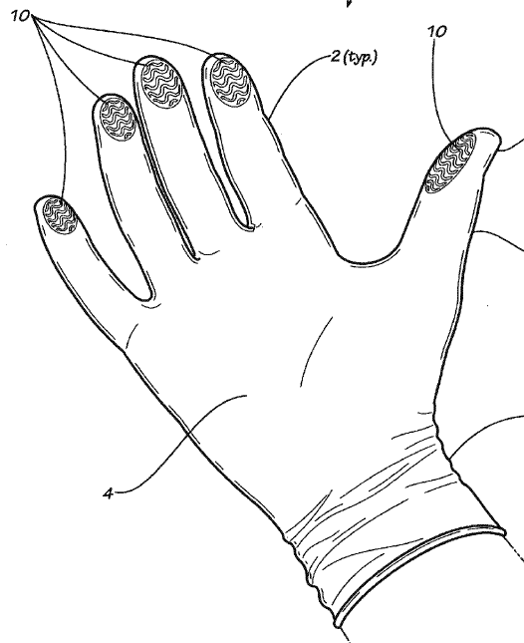
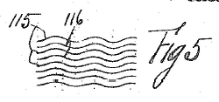
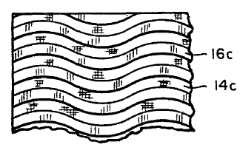
PDX 330

Slide 49
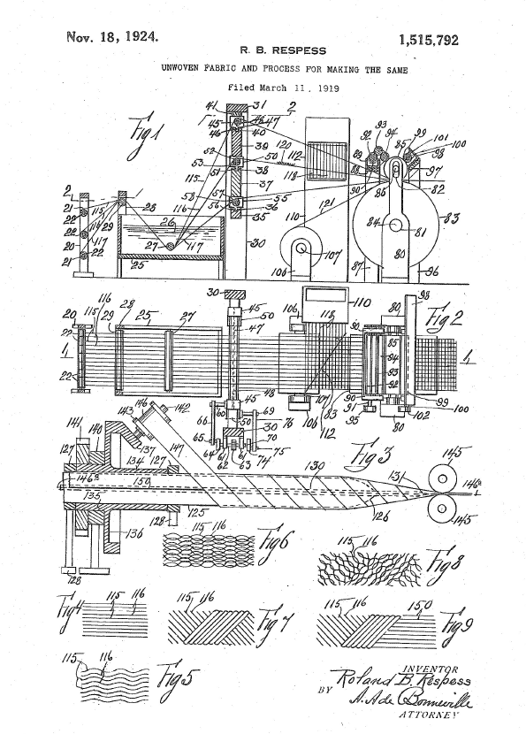
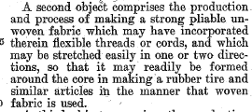
PDX 414

Slide 50
Columbia Sportswear N. Am., Inc. v. Seirus Innovative Access., Inc., 942 F.3d 1119 (Fed. Cir. 2019)
Judge found that most of Seirus’s prior art was “not relevant to a comparison between Columbia’s and Seirus’s designs for heat reflective material.”
“Blauer” was “[t]he only prior art that even approaches relevance.”

Slide 51
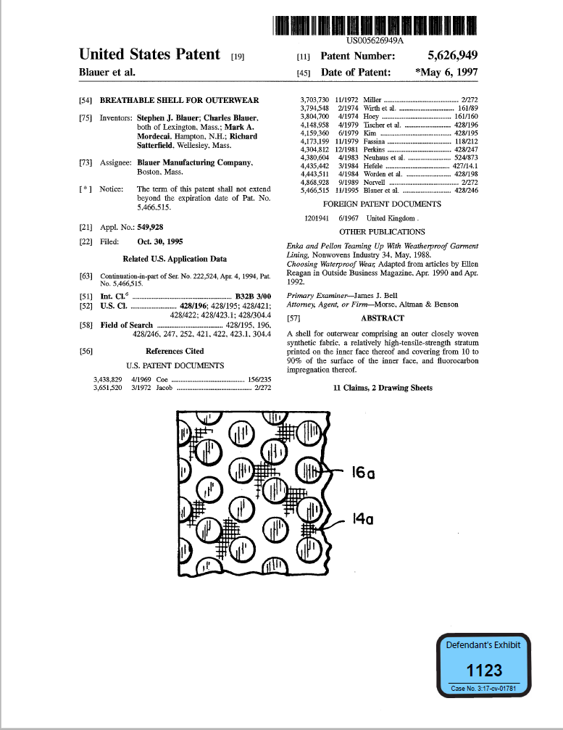
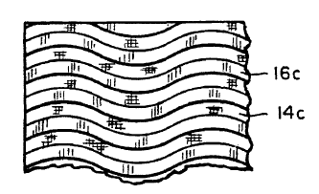
PDX 411

Slide 52
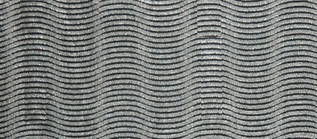
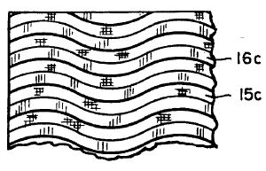
D’093 Patent | HeatWave | Blauer

Slide 53
Columbia Sportswear N. Am., Inc. v. Seirus Innovative Access., Inc., 942 F.3d 1119 (Fed. Cir. 2019)
Judge found that most of Seirus’s prior art was “not relevant to a comparison between Columbia’s and Seirus’s designs for heat reflective material.”
“Blauer” was “[t]he only prior art that even approaches relevance.”
“the contrasting waves of Seirus’s design are still substantially closer to the contrasting wave design disclosed in the D'093 patent than either Seirus’s or Columbia's design is to the pattern disclosed in” Blauer.
“The overall visual effect of the Columbia and Seirus designs are nearly identical.”
Jury awarded disgorgement of Seirus’s total profits from the sales of gloves of $3 million

Slide 54
Columbia Sportswear N. Am., Inc. v. Seirus Innovative Access., Inc., 942 F.3d 1119 (Fed. Cir. 2019)
“The district court’s evaluation of the prior art and its evaluation of wave thickness present another problem. In both instances, the district court made a finding of fact—whether an element of Seirus's design would give an ordinary observer a different visual impression than Columbia’ design—over a disputed factual record.”

Slide 55
Columbia Sportswear N. Am., Inc. v. Seirus Innovative Access., Inc., 80 F.4th 1363 (Fed. Cir. 2023)
At the remand trial:
Columbia sought to exclude Seirus’s prior art
Judge allowed the prior art in, ruling that “heat reflective” was merely functional language
Judge prohibited Columbia from distinguishing prior art on account that it was not “heat reflective material”

Slide 56
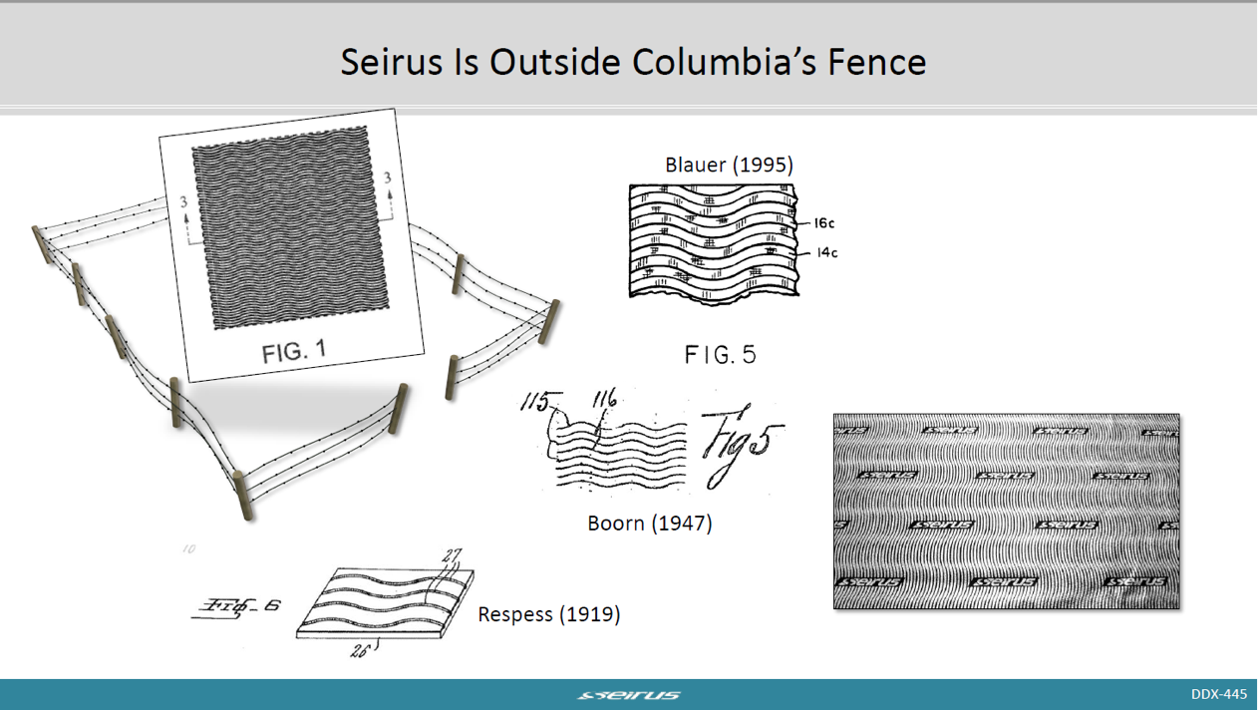
Columbia Sportswear N. Am., Inc. v. Seirus Innovative Access., Inc., 80 F.4th 1363 (Fed. Cir. 2023)

Slide 57
Columbia Sportswear N. Am., Inc. v. Seirus Innovative Access., Inc., 80 F.4th 1363 (Fed. Cir. 2023)
Jury found noninfringement

Slide 58
Columbia Sportswear N. Am., Inc. v. Seirus Innovative Access., Inc., 80 F.4th 1363 (Fed. Cir. 2023)
“the proper scope of comparison prior art that may be used in an infringement analysis is an issue of first impression for this court.”
“Columbia correctly states that a design-patent claim’s scope is limited to the article of manufacture identified in the claim (which here is heat reflective material), and it argues that the scope of comparison prior art should be likewise limited.”

Slide 59
Columbia Sportswear N. Am., Inc. v. Seirus Innovative Access., Inc., 80 F.4th 1363 (Fed. Cir. 2023)
“[T]o qualify as comparison prior art, the prior-art design must be applied to the article of manufacture identified in the claim.”
“First, doing so best accords with comparison prior art’s purpose”
“Second, [it] conforms with many cases in which courts considered such designs—including the cases most instructive on the role of comparison prior art.”
“Third, using the same scope for anticipatory prior art and comparison prior art makes good practical sense.”

Slide 60
Columbia Sportswear N. Am., Inc. v. Seirus Innovative Access., Inc., 80 F.4th 1363 (Fed. Cir. 2023)
Footnote 9:
“This is not to say that simply including some function with a claimed article's description (e.g., via naming or argument) will necessarily exclude articles from a design-patent claim's scope that would otherwise fall within it. For example, we suspect that, if a design patent were some-how granted for a design applied to a "flower pot for planting daisies," designs applied to prior-art flower pots not so designated could still anticipate. Including that additional function ("for planting daisies") would not necessarily render the article genuinely distinct from other flower pots.”

Slide 61
Columbia Sportswear N. Am., Inc. v. Seirus Innovative Access., Inc., 80 F.4th 1363 (Fed. Cir. 2023)
Flower pot for planting daisies
Daisy flower pot
Material for reflecting heat
Heat reflective material

Slide 62
Williamson v. Citrix Online, LLC, 792 F.3d 1339
(Fed. Cir. 2015) (en banc)
“In making the assessment of whether the limitation in question is a means-plus-function term subject to the strictures of § 112, para. 6, our cases have emphasized that the essential inquiry is not merely the presence or absence of the word ‘means’ but whether the words of the claim are understood by persons of ordinary skill in the art to have a sufficiently definite meaning as the name for structure.”

Slide 63
“Heat reflective materials are generally known in the apparel industry as referring to a base material with an applied layer of metallic foil or other similar metallic elements, such as shown and described at the following links.”
Declaration of Zachary Snyder Submitted Under 35 U.S.C. § 1.132

Slide 64
Source Identifiers

Slide 65
Columbia’s patented design
Seirus’s design
PDX 327

Slide 66
L.A. Gear, Inc. v. Thom McAn Shoe Co.,
988 F.2d 1117 (Fed. Cir. 1993)
“Design patent infringement relates solely to the patented design, and does not . . . allow of avoidance of infringement by labelling.”

Slide 67
Unette Corp. v. Unit Pack Co.,
785 F.2d 1026, 1029 (Fed. Cir. 1986)
“Likelihood of confusion as to the source of the goods is not a necessary or appropriate factor.”

Slide 68
Braun Inc. v. Dynamics Corp. of Am.,
975 F.2d 815, 828 (Fed. Cir. 1992)
“purchasers’ likelihood of confusion as to the source of a good is a necessary factor for determining trademark and trade dress infringement, . . . [A] different quantum of proof applies to design patent infringement, which does not concern itself with the broad issue of consumer behavior in the marketplace”

Slide 69
Columbia Sportswear N. Am., Inc. v. Seirus Innovative Access., Inc., 942 F.3d 1119 (Fed. Cir. 2019)
“A would-be infringer should not escape liability for design patent infringement if a design is copied but labeled with its name. But L.A. Gear does not prohibit the fact finder from considering an ornamental logo, its placement, and its appearance as one among other potential differences between a patented design and an accused one. Indeed, the fact finder is tasked with determining whether an ordinary observer would find the ‘effect of the whole design substantially the same.’ . . . It would be inconsistent with this mandate to ignore elements of the accused design entirely, simply because those elements included the name of the defendant.”

Slide 70
Columbia Sportswear N. Am., Inc. v. Seirus Innovative Access., Inc., 80 F.4th 1363 (Fed. Cir. 2023)
“In design-patent-infringement cases involving logos, we appreciate the potential for a jury to be led astray and mistakenly conflate the significance of a logo's source-identifying function with whatever impact it might have on a comparison of the designs. But district courts are in the best position to decide whether and when to provide clarification in the course of conducting a trial. And here we see no legal error or abuse of discretion in the district court's jury instructions, which are the only subject of Columbia's challenge on this issue.”

Slide 71

Damages?

Slide 72
Claimed Article of Manufacture
Infringing Product
Anticipation
Prior Art
Comparison
Prior Art

Slide 73
“The claim is not directed to a design per se, but a design for an identified article.”
“[T]ying the design pattern to a particular article provides more accurate and predictable notice about what is and is not protected by the design patent.”
Curver Luxembourg, SARL v. Home Expressions, Inc.,
938 F.3d 1334 (Fed. Cir. 2019)
“A design claim is limited to the article of manufacture identified in the claim
a ‘[d]esign is inseparable from the article to which it is applied . . . .
In re SurgiSil, L.L.P. 14 F.4th 1380 (Fed. Cir. 2021)

Slide 74
Samsung Elecs. Co. v. Apple Inc.,
580 U.S. 53 (2016)
“Arriving at a damages award under § 289 thus involves two steps. First, identify the ‘article of manufacture’ to which the infringed design has been applied. Second, calculate the infringer’s total profit made on that article of manufacture.”

Slide 75
Samsung Elecs. Co. v. Apple Inc.,
580 U.S. 53 (2016)
“[t]he term ‘article of manufacture’ is broad enough to encompass both a product sold to a consumer as well as a component of that product.”

Slide 76
Samsung Elecs. Co. v. Apple Inc.,
580 U.S. 53 (2016)
U.S. Patent No. D593,087:
“The ornamental design of an electronic device, substantially as shown and described.”

Slide 77
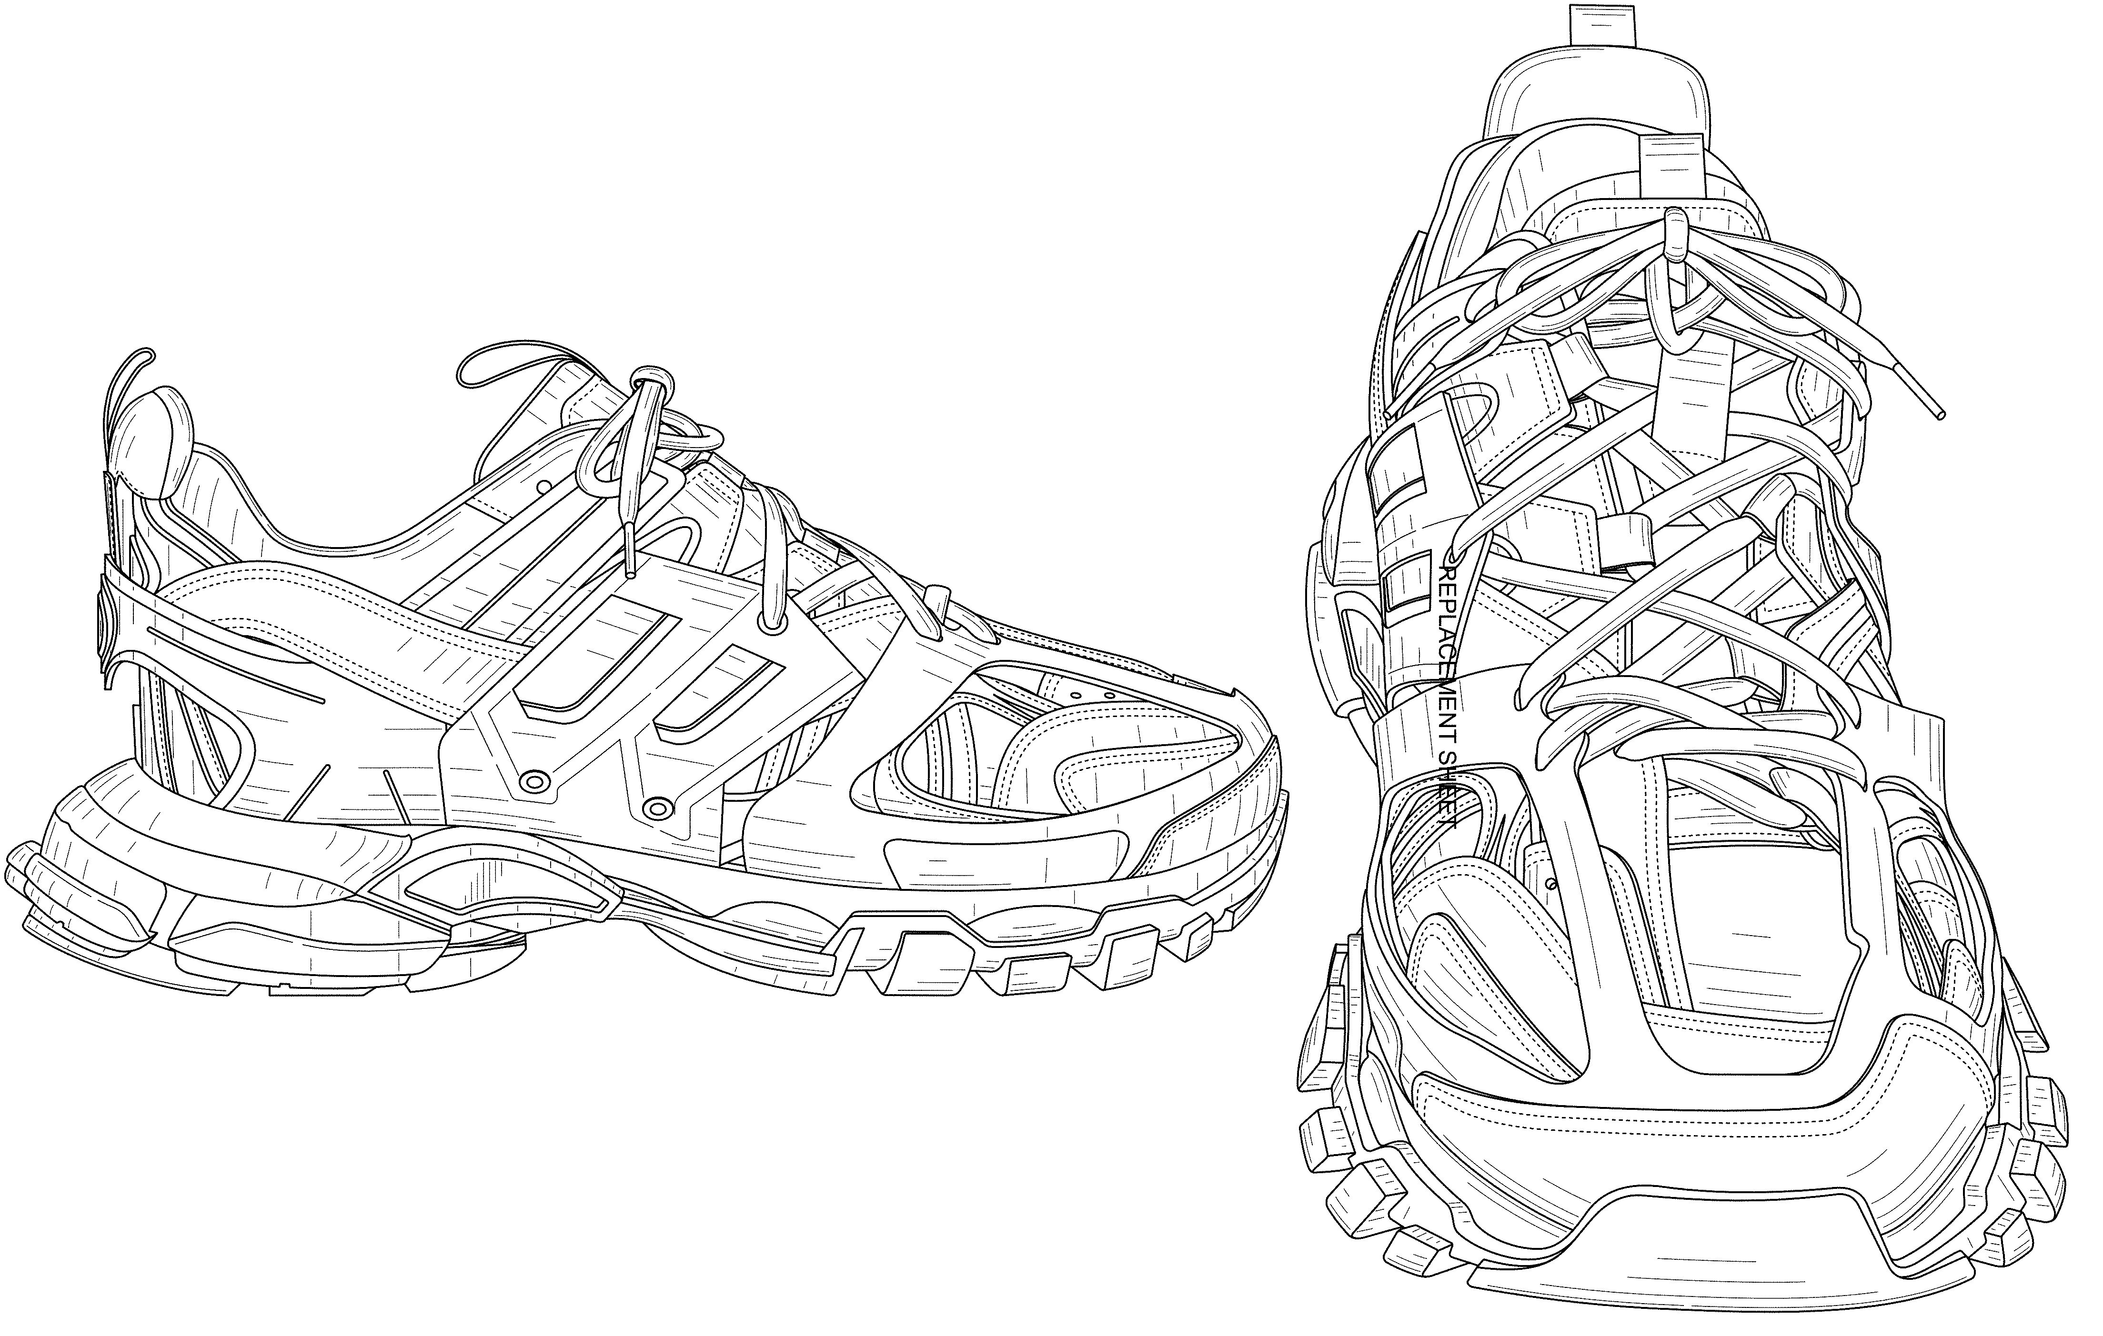

Slide 78
Epilogue

Slide 79
Columbia Sportswear N. Am., Inc. v. Seirus Innovative Access., Inc.
March 2016 – Stipulated judgment of validity
Remand trial set for December 2024
June 2024 – In light of LKQ, Seirus files motion to vacate stipulation of validity pursuant to Fed. R. Civ. P. 60(b)(6)
October 2024 – District court grants motion

Slide 80

Nika Aldrich
Shareholder
As a leader of Schwabe’s IP Litigation Group, and first-chair litigator, I am part of a talented team who handles complex, high-stakes, and technical litigations in the federal court system.
I have represented companies nationwide in numerous disputes including a number of patent and other intellectual property cases, cases of constitutional significance, bankruptcy matters, and other matters where there is a critical need for an attorney who can break down and explain complex principles, technologies, and legal concepts.
503-796-2494
naldrich@schwabe.com

Slide 81




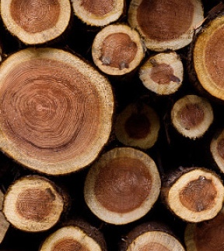


INDIAN COUNTRY
AND ALASKA NATIVE
CORPORATIONS
HEALTHCARE AND
LIFE SCIENCES
REAL ESTATE AND
CONSTRUCTION
CONSUMER PRODUCTS, MANUFACTURING,
AND RETAIL
NATURAL RESOURCES
TECHNOLOGY
PORTS AND MARITIME

