Slide 1
Insights from Europe:
Trends and Practice updates
Dr Nick Palmer
December 3 2025

Slide 2
Trends and Practice updates
Trends in Europe
  Analysis by numbers
  Common objections at the EPO
  European case law and strategy updates
  Drafting with Europe in mind – minimizing objections and expense
EPO approach to AI and Machine Learning
  Associated drafting tips
Post-grant strategy
  Updates from the Unified Patent Court and effect on freedom to operate in Europe

Slide 3
Trends in Europe

Slide 4
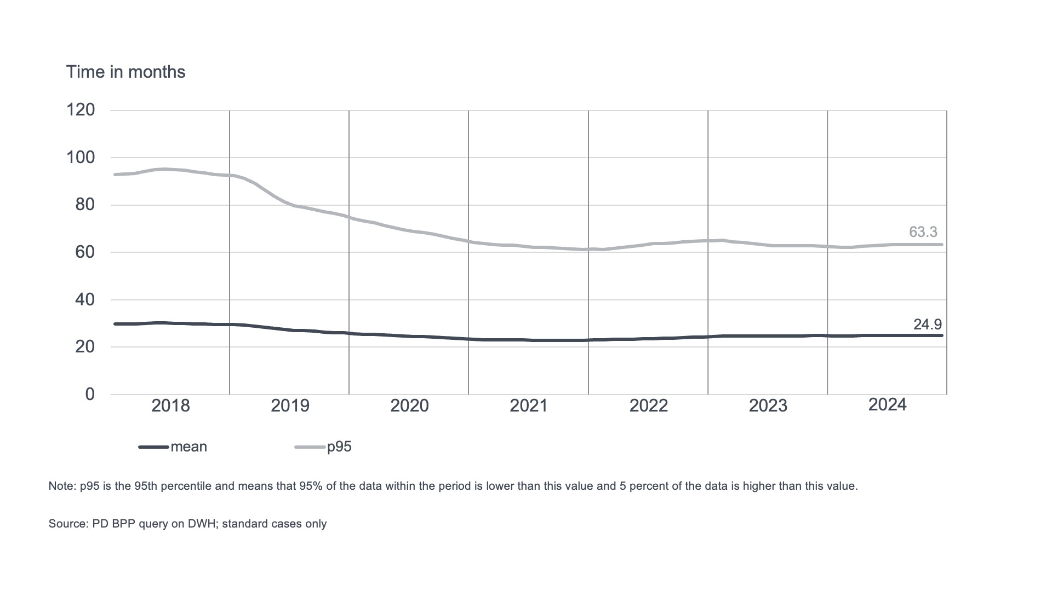
Trends at the European Patent Office – Timescales
Duration of examination – 25 months average
Notes:
This illustrates the average timescales for examination at the EPO; from the point at which the Examining Division takes responsibility (i.e. after search).
Around 2 years on average.
95 % completed within 5(ish) years.

Slide 5
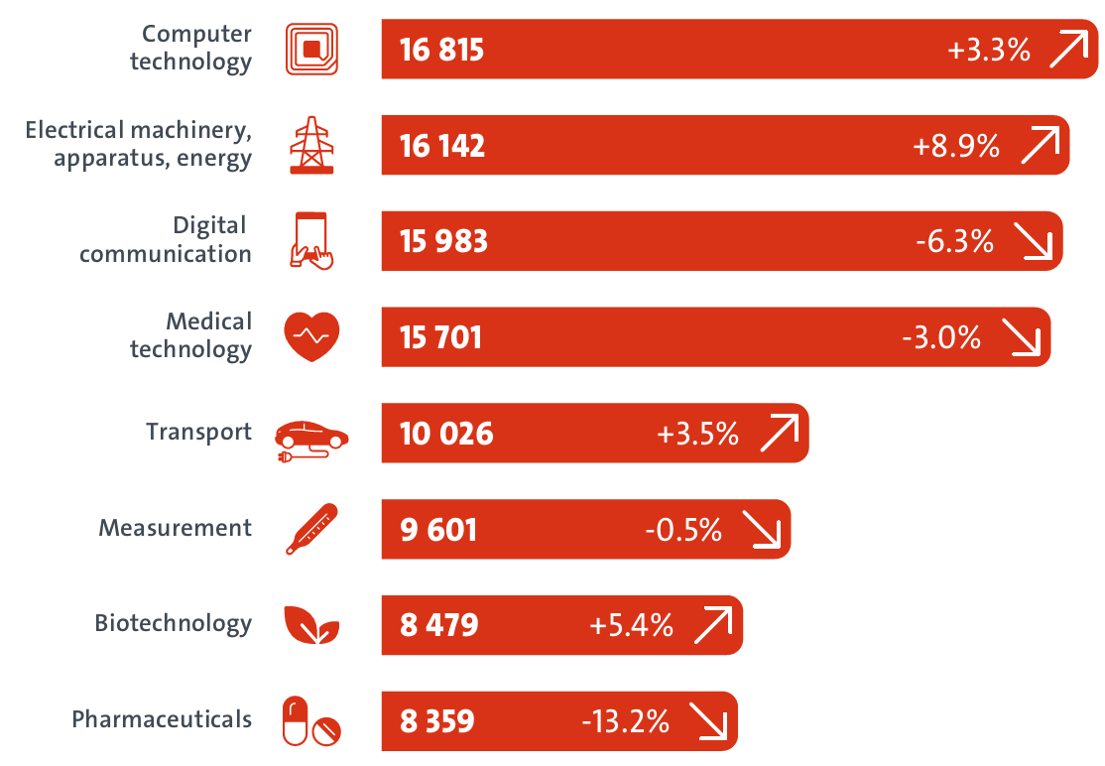
Trends at the European Patent Office – Technology trends
Technology trends in new filings
Credit to EPO: epo.org/patent-index2024
Notes:
Steady growth in computer technology apps.
The fall in grant rates between 2019 and 2022 appears tied to the Covid lockdowns; seen across all technologies.
Given that no slow down in filing in this field, has created a backlog in prosecution compared to other fields.

Slide 6
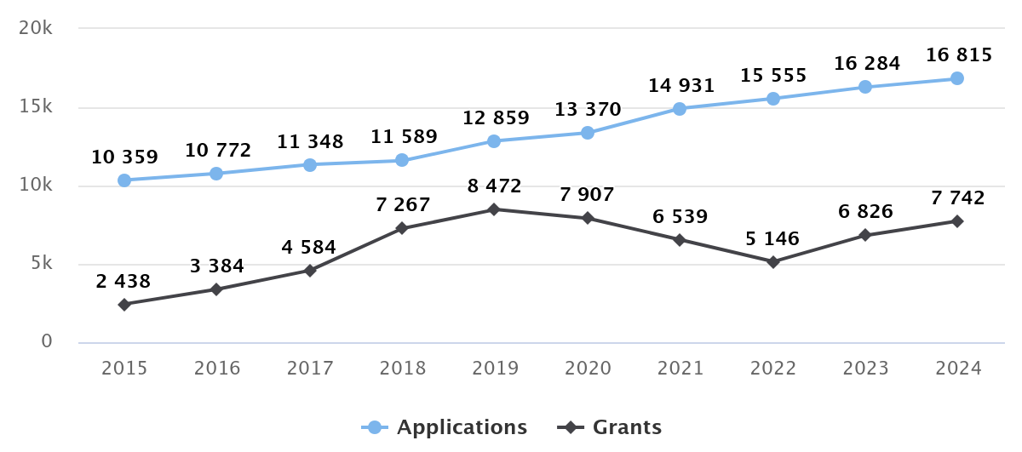
Trends at the European Patent Office – Computer technologies
Computer technology applications and grants
Notes:
Steady growth in computer technology apps.
The fall in grant rates between 2019 and 2022 appears tied to the Covid lockdowns; seen across all technologies.
Given that no slow down in filing in this field, has created a backlog in prosecution compared to other fields.

Slide 7
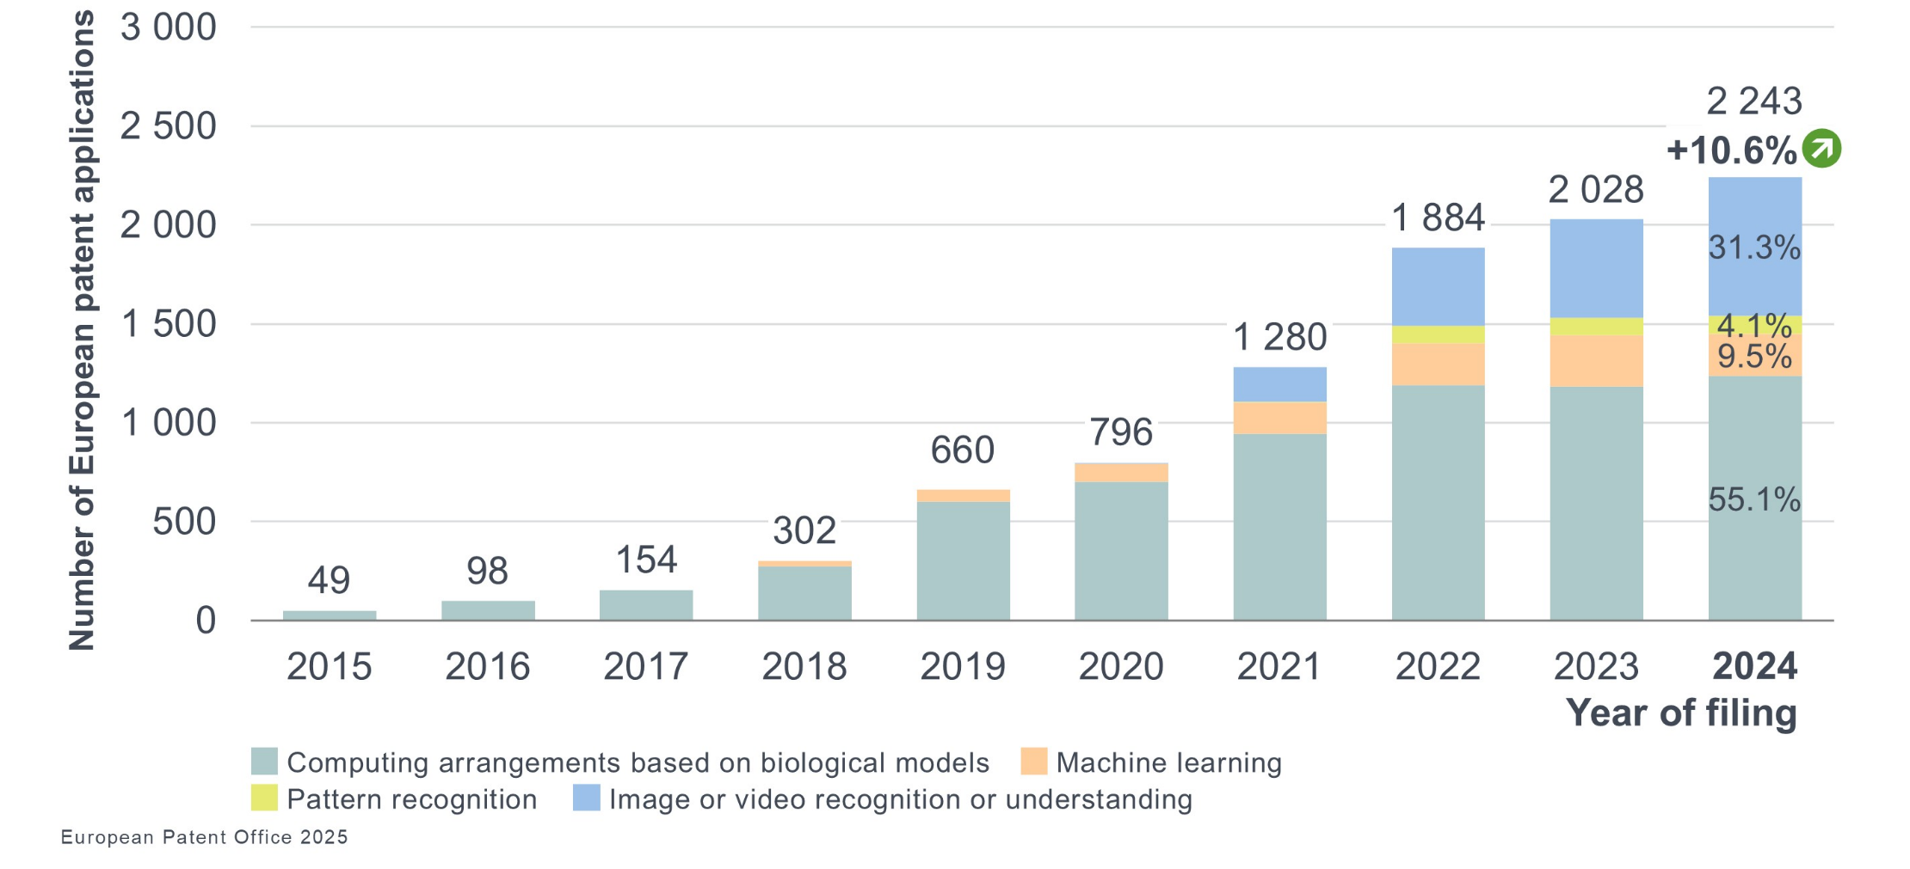
Trends at the European Patent Office – AI
European patent applications – areas of artificial intelligence
Notes:
>10% year on year growth in AI filings.
Blue – image/video recognition – 31%
Yellow – pattern recognition – 4%
Orange – Machine learning – 10%
Grey – computing arrangements based on biological models (i.e. ANNs) – 55%

Slide 8
European objections
Drafting with Europe in mind

Slide 9
Drafting with Europe in mind
Colour drawings now accepted by the EPO (as of 1 October 2025)
EPO has some “quirks” mainly related to its strict approach to added subject matter
Many of these can be addressed in advance by preparing the specification to meet an “EPO style” as far as possible
Test: subject-matter must be clearly and unambiguously disclosed in the application as originally filed
Multiple dependency in the claim set at the time of filing the application (PCT filing, if regional phase of PCT) means that there is indisputable basis for the claimed combinations of features

Slide 10
Article 123(2) EPC: added subject-matter
Amendment does not require exact wording for support
However, …
  If the new term has the same meaning, then why alter it?
  If it has a different meaning, will present added matter if lacking clear support
If amended claims are filed without a thorough explanation of support for the amendments, the examiner may issue a communication requesting that support be identified before examining further
When drafting describe all embodiments collectively, if possible, and explicitly highlight all optional/interchangeable features

Slide 11
Article 123(2) EPC: added subject-matter
(Relatively) “Safe” added matter
  making “intermediate generalisations” by amending a claim to include one feature in isolation from a passage disclosing it as one of multiple features in context
  Why is this (relatively) “safe”? Because if challenged, it can be amended after grant by a narrowing amendment to include the missing second feature
“Unsafe” added matter
  By contrast, using new or different terminology, or basing an amendment on a drawing, may result in introducing an unsafe amendment
  In opposition, if challenged, the natural reaction would be to delete it
  However – this may not be possible without broadening beyond the scope of the granted patent – contravening Article 123(3) EPC

Slide 12
How to structure a claim set for EPO prosecution
Excess claims fees
  $320 per claim, for claims 16-50
  $800 per claim, for claims 51+
These can be avoided by combining dependent claims with “AND/OR” statements, or “OR” statements to preserve original dependencies
May keep subject-matter in the claim set using “optionally”, but examiner will not take account of that matter when searching / examining the claim
Consider including numbered clauses in the description to match the claim wording you would like to keep within the application for filing continuations

Slide 13
How to structure a claim set for EPO prosecution
EPO will not usually examine multiple independent claims in the same category
  Exceptions for “plug / socket” or “transmitter / receiver” type inventions
Often possible to rewrite claims to depend from a single independent claim
When reducing a claim set on EP regional phase entry there is no point wasting claims on multiple independent claims in the same category since they will not be allowed to remain in the application

Slide 14
How to structure a claim set for EPO prosecution
EP direct / divisional applications
  Stuck with claim order as filed – no right to amend until after search report
  If lack of unity, EPO may ask applicant to select claims to be searched – but not always!
  EPO may draw up partial search report for first independent claim - only option then is to pay additional search fees if later claims are to be searched
  If additional fees not paid, then unsearched claims can only be pursued in a divisional – the EPO will not allow the claims to remain in the application (even if sharing an inventive concept as dependent claims)

Slide 15
How to structure a claim set for EPO prosecution
EP-PCT applications
  More flexibility as claims can be amended at Rule 161/2 stage (~7 months after filing)
  Lead with the most important independent claim
  Ideally, only one independent claim in each category (system, apparatus, method)
  Beware of broadening dependencies of claims at this stage – may comprise added subject matter
  If EPO was the ISA, search fees will be due if first independent claim was not previously searched

Slide 16
EPO grant stage considerations
EPO is the only territory which requires conformity of specification with allowed claims
Options
  1) delete subject matter not covered by claims (paragraphs of text / figures from drawings)
  2) explicitly state that subject matter does not fall within scope of invention
With either option, amendment can be very time consuming and might add matter
Note that leaving in unclaimed alternatives to a claimed solution might be problematic
  In the UK there is case law which sets precedent that doing so would limit the scope for the UK’s doctrine of equivalents – an alternative cannot be covered by the claims as an “equivalent” if it was described and not claimed – as there was clear intention not to cover that scope

Slide 17
EBoA* decision G1/24
Interpretation of claims
(*Enlarged Board of Appeal)

Slide 18
Recent Enlarged Board of Appeal decisions – G1/24
Previously it was considered that the claims should stand alone – the language of the claims must be clear and unambiguous when read in isolation
G1/24 concludes that the claims are a starting point, but that the description and drawings must always be consulted to interpret the claims for the assessment of patentability
This moves away from previous decisions in which it was decided that the description should be referred to only in the case of unclarity or ambiguity within the claims

Slide 19
Recent Enlarged Board of Appeal decisions – G1/24
The point of contention was whether claim 1 was novel
Claim 1 covered an article for a vaping device, requiring a “gathered sheet” material
“Gathered sheet” is a term with a known meaning in the industry
The patentee argued that if the term is given its usual meaning in the art, claim 1 is novel
Opponent argued that it must instead be given a broader definition as set out in the description of the patent, in which case claim 1 lacks novelty over relevant prior art
The EBoA found that the definition given in the description must be used to interpret the claim, despite the term having a clear meaning when read in isolation
Notes:
This case has been applied in a more recent decision in which the Board of Appeal found that the claim must be interpreted more broadly.
Claim included a yaw rate sensor. Description referred only to a gyroscopic sensor which is a sensor capable of measuring yaw rate.
Patentee argued that yaw rate sensor should be construed narrowly to have a particular meaning distinct from the gyroscopic sensor (i.e. the claim does not cover the only worked embodiment in the specification). Prior art taught gyroscopic sensors, and the BoA found that the claim must be construed to cover the only described embodiment and so must cover the gyroscopic sensor.

Slide 20
Summary of drafting tips

Slide 21
Key drafting points
Think carefully about claim structure before filing – lead with the most important claims to ensure they are searched
Ensure that international applications contain multiple dependencies where possible – or include clauses in the description, having those multiple dependencies
Where possible, avoid describing multiple features in combination
Use clear terminology and avoid swapping terminology in the claims unless replacing a term with a given definition
Avoid using speculatively-broad definitions for well-understood terms
Avoid references to ‘the invention’ to limit amendment at grant stage

Slide 22
EBoA decision G1/23
Disclosure by market availability

Slide 23
Recent Enlarged Board of Appeal decisions – G1/23
When does a prior disclosure of a product have prior art effect in Europe?
Previous case law G1/92 required an enabling disclosure of the invention
  In the context of a chemical composition, it forms part of the state of the art when the product is available to the public and can be analysed and reproduced by the skilled person without undue burden
G1/23 removes this requirement
  A product cannot be excluded from the state of the art for the sole reason that its composition or internal structure could not be analysed and reproduced by the skilled person before that date
  The decision removes the requirement for reproducibility
  Requirement for the product to be capable of analysis remains, although extent is unclear

Slide 24
Recent Enlarged Board of Appeal decisions – G1/23
The cases considered in this area to date have related to chemistry
Our view is that this also applies to software disclosures
  There is no longer a requirement for a software product to be reproducible to form part of the state of the art
  Simply being open to analysis may now be sufficient for a software invention to be on the market even if it cannot be reverse-engineered
Remember – no grace period for disclosures stemming from the inventor or applicant
  (This applies to UK / EPO – some European territories do allow a grace period)

Slide 25
EPO approach to examining AI claims

Slide 26
EPO analysis of a software claim
EPO requires claimed subject matter to possess a technical character
  Any hardware device should suffice – business schemes or purely mathematical methods excluded
Software objections usually arise under consideration of inventive step
  Assessment of claim features contributing to the technical character of the invention
  Inherently non-technical features may be ignored when considering the inventive step
  A non-technical feature may contribute to the overall technical character if it interacts with the other features to provide a “further technical effect” above simply running on a computer
Example:
  a data file may contribute to technical character depending on its content
  parameters affecting hardware operation – yes // a customer address – no

Slide 27
EPO analysis of AI inventions
AI and ML models are viewed as abstract mathematical methods unless claimed in a technical setting – a claim to a machine learning model itself will not be accepted
Terms such as “support vector machines”, “neural networks”, “reasoning engines” may not necessarily require use of a computer – always claim their use in context of a technical system
EPO will assess whether the AI implementation has technical character
  Use of an ANN in a medical device to identify irregular sensor readings
  Classification of digital images, videos or speech signals in many contexts
  Note that classifying text files based on their text content is deemed a linguistic issue and not a technical problem, so would be assessed not to provide a technical character

Slide 28
EPO analysis of ML inventions
The technical effect a ML algorithm achieves may be readily apparent or established by explanations, mathematical proof, or experimental data
The EPO guidelines state that “Mere assertions are not enough, but comprehensive proof is not required either” -- very clear guidance!
If the technical effect depends on particular characteristics of the training dataset used, the characteristics required to reproduce the technical effect must be disclosed
… unless the skilled person can determine them without undue burden using common general knowledge
In general, there is no need to disclose the specific training dataset itself

Slide 29
Machine Learning case law

Slide 30
European Patent Office – sufficiency of disclosure
T1669/21 (Art 83 EPC – Sufficiency of disclosure)
Claim 1 is directed to a method of determining the condition of a refractory lining in a metallurgical vessel using a “computational model”
The patentee argued that “computational model” implies the use of a machine learning model
The Board of Appeal (BoA) disagreed – found that computational models may also include analytical models
The disclosure did not enable the use of an analytical model in the context of the claimed method – patent was revoked

Slide 31
European Patent Office – sufficiency of disclosure
Claim at issue in T1669/21 [Translated from German]
Method for determining the condition of the refractory lining of a vessel containing molten metal,
where data relating to this refractory lining (12), such as materials, wall thickness, installation method and other information, are recorded, measured and evaluated,
characterized in that
the following measured or determined data of a respective vessel (10) are comprehensively collected and stored in a data structure, namely
  the initial refractory lining of the inner vessel lining (12), with regard to materials, material properties, wall thicknesses of bricks and injection materials as maintenance data;
  Production data during use, relating to melt quantity, temperature, composition of the melt or slag and its thickness, tapping times, temperature profiles, treatment times and metallurgical parameters;
  Wall thicknesses of the lining after the insertion of a vessel (10) at least at points with the greatest degree of wear;
  further process parameters relating to the method of filling or tapping the molten metal into or out of the vessel (10);
And that a computational model is created from the measured or determined data or parameters of the care data, the production data, the wall thicknesses and the process parameters, by means of which these data or parameters are evaluated by calculations and subsequent analyses,
wherein the computational model is adapted from the measurements of the wall thicknesses of the lining (12) after a number of taps by means of a regression analysis,
by which the wear is calculated taking into account the collected and structured data.

Slide 32
European Patent Office – sufficiency of disclosure
The EPO Guidelines were this year updated to reflect case law in this area
“Another example [of insufficiency] can be found in the field of artificial intelligence if the mathematical methods and training datasets are disclosed in insufficient detail for the skilled person to be able to reproduce the technical effect without undue burden using common general knowledge over the whole scope of the claim (see G-II, 3.3.1).”
Include explicit reference to AI / ML techniques – describe the architecture, training and implementation
Describe relevant aspects of the training process, and parameters for training the model
  Size of the training set
  Source of the training data
  Format of training data
  Parameters relevant for the model to perform its claimed technical function
Notes:
Enabled “over the whole scope of the claim”… this comes about where the invention is claimed in a way that relies on achieving a certain outcome. If the outcome is not achieved by certain examples, the patent is insufficient. So, if a result is required you must substantiate the method with theory and worked examples to explain how it works in any given case.

Slide 33
European Patent Office – lack of a technical implementation
T 0702/20 (ML for object recognition)
The claims were directed to a hierarchical neural network apparatus
The neural network apparatus was found to provide a new and non-obvious structure (involving connecting layers according to a matrix encoding a parity error checking code) before training the ANN
The new structure was assessed to address the problem of overfitting training data
However, the ANN is a mathematical model – no technical contribution – no inventive step
The application was refused for lacking an inventive step

Slide 34
European Patent Office – lack of a technical implementation
Claim at issue in T 0702/20
A hierarchical neural network apparatus (1) implemented on a computer comprising
a weight learning unit (20) to learn weights between a plurality of nodes in a hierarchical neural network, the hierarchical neural network being formed by loose couplings between the nodes in accordance with a sparse parity-check matrix of an error correcting code, wherein the error correcting code is a LDPC code, spatially-coupled code or pseudo-cyclic code, and comprising an input layer, intermediate layer and output layer, each of the layers comprising nodes; and
a discriminating processor (21) to solve a classification problem or a regression problem using the hierarchical neural network whose weights between the nodes coupled are updated by weight values learned by the weight learning unit (20)
or comprising
a weight pre-learning unit (22) to learn weights between a plurality of nodes in a deep neural network, the deep neural network being formed by loose couplings between the nodes in accordance with a sparse parity-check matrix of an error correcting code, wherein the error correcting code is a LDPC code, spatially-coupled code or pseudo-cyclic code, and comprising an input layer, a plurality of intermediate layers and an output layer, each of the layers comprising nodes; and
a discriminating processor (21) to solve a classification problem or a regression problem using the deep neural network whose weights between the nodes coupled are updated by weight values learned by the weight pre-learning unit (22)
and
a weight adjuster (23) to perform supervised learning to adjust the weights learned by the weight pre-learning unit (22) by supervised learning; and wherein
the weights are learned by the weight pre-learning unit (22) by performing unsupervised learning; and
the weights between the nodes coupled are updated by weight values adjusted by the weight adjuster (23).

Slide 35
European Patent Office – lack of a technical implementation
The new structure was assessed to address the problem of overfitting training data
However, the ANN is a mathematical model – no technical contribution – no inventive step
The application was refused for lacking an inventive step

Slide 36
European Patent Office – lack of a technical implementation
T 1952/21 (Reinforcement learning)
“A machine learning system” was claimed with no tie to a specific technical implementation
The invention related to improving a reinforcement learning process by introducing a degree of randomness in the training process

Slide 37
European Patent Office – lack of a technical implementation
Claim at issue in T1952/21
A machine learning system (10), comprising:
an input unit (20);
a processing unit (30);
and an output unit (40);
wherein, the input unit is configured to provide the processing unit with input data;
the processing unit is configured to process the input data to generate processing path input data;
the processing unit is configured to implement a first processing path comprising a feed-forward neural network to process the processing path input data to generate first intermediate data;
the processing unit is configured to implement a second processing path comprising a feed-forward neural network to process the processing path input data to generate second intermediate data, wherein said feed-forward neural network comprises stochastic units;
the processing unit is configured to implement a value output path comprising a feed-forward neural network to process the first intermediate data and the second intermediate data to generate value output data;
the processing unit is configured to implement a policy output path comprising a feed-forward neural network to process the first intermediate data and the second intermediate data to generate policy output data; and
wherein, the output unit is configured to output the value output data and output the policy output data.

Slide 38
European Patent Office – lack of a technical implementation
A claim limitation was presented covering
    A machine learning system (10) for reinforcement learning of control policy output data configured for controlling an engine, or valve, electrical circuit, or heating system, or robotic arm, or aerial drone, or humanoid robot, or self-driving vehicle …
The invention was said to have particular application in anti-lock braking systems
The patentee argued that the invention would result in an improvement to a machine learning system applied to any context
The Board of Appeal disagreed – “the Board does not see sufficient evidence, be it by theoretical considerations, or by experiments, to conclude that a technical effect is present over the full breadth of the claim”
Found to lack an inventive step

Slide 39
European Patent Office – performance across scope claimed
T 1425/21 (Training Distilled Machine Learning Models / Google)
The application claimed a method of
  Training a first machine learning model [on a classification task]
  Training a second machine learning model having a different architecture with fewer parameters so requiring less memory than the first, by
    Processing each training input to generate a target ‘soft’ output
    Training the second model for each training input to generate a soft output matching the target
    Wherein the soft scores satisfy a given equation
In essence, the method creates a second machine learning model that is smaller than the first, requiring less storage, while approximating its output

Slide 40

European Patent Office – performance across scope claimed
Claim at issue in T 1425/21
A method performed by one or more computers, the method comprising:
training a first machine learning model, wherein the first machine learning model is configured to receive an input and generate a respective score for each of a plurality of classes representing a probability that the class is a classification of the input; and
training a second machine learning model on a plurality of training inputs, wherein the second machine learning model is also configured to receive inputs and generate scores for the plurality of classes representing a probability that the class is a classification of the input, wherein the second machine learning model has a different architecture to the first machine learning model and has fewer parameters than the first machine learning model such that generating output from the second machine learning model requires less memory than generating output from the first machine learning model, the training comprising:
processing each training input using the first machine learning model to generate a first target soft output for the training input; and
training the second machine learning model to, for each of the training inputs, generate a soft output that matches the first target soft output for the training input, wherein the first target soft output and the soft output that matches the first target soft output comprises a respective soft score for each of the plurality of classes generated by a last layer of the respective machine learning model, and wherein each soft score satisfies:
wherein qi is the score for a class i, zi is a weighted combination of outputs of a previous layer of the respective machine learning model received by the last layer, j ranges from 1 to a total number of classes in the plurality of classes, T is a temperature constant, and wherein to generate the soft scores, T is set to a higher value than used to generate scores for the classes after the respective machine learning model has been trained.

Slide 41
European Patent Office – performance across scope claimed
The Board of Appeal noted that the novel features (in fact, all of the features) relate to a mathematical method which cannot contribute to the assessment of inventive step unless having a causal link to a technical effect
Applicant argued that there is such a link – the reduced size model requires lower memory
However, it was found that a reduction in memory or computational requirements of a machine learning model is insufficient, by itself, to establish a technical effect
  One has to consider the performance of the “reduced” learning model
“It is not credible in general that any model with fewer parameters can be as accurate as the more complex one it is meant to replace.”
Failed to provide an inventive step across the entire scope of the claim – application refused for lacking an inventive step
Notes:
Applicant argued that if the outputs are trained to match, the model must perform to the same accuracy. The BoA considered this is not plausible – the resulting model would need the same complexity to encode those outputs

Slide 42
European Patent Office – use of AI in proceedings
T1193/23 (Use of AI during proceedings)
During appeal oral proceedings responses from ChatGPT were verbally submitted to the hearing, to support interpretation of technical terms
Extract from the decision:
  "The general increase in the spread and use of chatbots based on language models ('large language models') and/or 'artificial intelligence' alone does not justify the assumption that a received answer - which is based on training data unknown to the user and can also depend sensitively on the context and the exact formulation of the question(s) - necessarily correctly reflects the expert's understanding of the respective technical field (at the relevant time).“
A general-purpose LLM cannot be relied on to verify the knowledge of the skilled person
Appropriate technical literature should be used instead

Slide 43
Key points
Ensure the machine learning model is tied to a specific technical implementation
  If the invention really lies at the ML model level, this may mean the applicant is forced to pick a selection of use-cases and file divisionals to cover off the key commercial uses
Ensure the specification contains a description of a model that can be used
  Include detail of the architecture (may only need a very broad statement – depends on where the invention lies)
  Include detail of a training process and suitable training data
Ensure that the alleged technical benefits are supported across the entire claim scope
Don’t use ChatGPT to supply argumentation during hearings

Slide 44
Position in the UK

Slide 45
United Kingdom - position on machine-learning inventions
Emotional Perception AI Limited v Comptroller General of Patents, currently on appeal to the UK Supreme Court
Claimed matter relates to a system and method for recommending media tracks to users, using an Artificial Neural Network (ANN) trained to perceive semantic similarity of media
  The invention was assessed to lie in the training and implementation of the ANN
  The UKIPO refused the application on the basis that this lies solely in a program for a computer (so is excluded from patentability in the UK)
    “The ANN-based system for providing semantically similar file recommendations is not technical in nature”
This was appealed to the UK’s High Court, which overturned the decision, finding that since an ANN can be embodied in hardware, inventions implemented using ANNs should not be excluded as relating to computer programs

Slide 46
United Kingdom - position on machine-learning inventions
This was subsequently overturned again by the UK Court of Appeal
For the second time in 18 months, the UKIPO edited its guidelines on patentability of AI inventions to reverse the outcome of its list of worked examples
The decision is now under appeal again with the UK’s Supreme Court – we await the decision
A positive decision from the Supreme Court might again reverse the UK’s position – opening up the UK as a great venue for AI-related patents
Watch this space…

Slide 47
Position in the United States

Slide 48
United States - Ex Parte Desjardins et al.,
U.S. Appl. No. 16/319,040 (DeepMind Technologies Ltd) relates to a method of training an ML model, the method being said to reduce storage capacity, complexity, and to retain knowledge of previous tasks
The PTAB previously issued a rejection that [paraphrasing] the claims recite a mathematical calculation, with no additional elements that integrate it into a practical application
USPTO Director John A Squires convened the Appeals Review Panel, which issued a decision on September 26th, reversing the PTAB
While the claims may recite an abstract idea, they reflect improvements to computer functionality
Notes:
PTAB – failed the pass the “2 prong” test set out in Alice – 1st being the abstract maths calc, the 2nd being whether it regardless integrates into a practical application

Slide 49
United States - Ex Parte Desjardins et al.,
The decision makes a policy statement that “categorically excluding AI innovations from patent protection in the United States jeopardizes America’s leadership in this critical emerging technology”
Interested to hear views on whether this marks a significant change in USTPO practice

Slide 50
United States - Ex Parte Desjardins et al.,
Interesting to compare the allowed US claims to the allowed European claims
US claims recite that the ML model has been trained on a first task using first training data to determine a first set of parameters of the model
In broad terms the claimed method involves
  Determining importance of the parameters to the first ML task [steps omitted here]
  Obtaining second training data for the ML training model on a second task
  Training the model on the second task using the second training data to adjust the first parameter values to optimise the model for the second task while protecting the performance of the model on the first task using a function based on a penalty term linked to the measure of importance of the first parameters as determined above
Notes:
PTAB – failed the pass the “2 prong” test set out in Alice – 1st being the abstract maths calc, the 2nd being whether it regardless integrates into a practical application

Slide 51
Comparison to the allowed European claims
EP4231197 and EP3485432
EP4231197 recites explicitly that the values of parameters found to be more important to the model on the first task are “more strongly constrained” during the second training step
The terminology “optimising” the model on the second task during the training step has changed to “achieving an acceptable level of performance on the second task”
The claim recites more detail of the model – that it comprises a deep neural network with an input layer, one or more hidden layer each applying a non-linear transform to an input to generate an output, wherein the output is generated based on the input and on the values of the parameters of the model

Slide 52
Comparison to the allowed European claims
Finally, the claims recite that the two tasks each comprise reinforcement learning tasks in which a robotic agent interacts with a real-world environment to perform the task
EP3485432 differs from EP’197 by claiming the tasks in a different way – that each is an image recognition task requiring recognition of a different object or pattern in an image
These differences highlight the requirement to tie the ML invention to a technical problem – differing from the US claim language in which no specific technical implementation is claimed

Slide 53
Post-grant strategy
UPC: Should we opt out?

Slide 54
UPC: Should we be filing opt-outs?
YES
Opting out prevents a competitor locking the patent to the UPC’s jurisdiction
… unless obtaining a unitary patent – in which case there is no option to opt out
Remember – the Unified Patent Court should not be conflated with Unitary Patents
  For the 18 member states, a national validation may be litigated either at the UPC (unless opted out) or at its respective national court
  A Unitary Patent will cover all 18 member states and can only be litigated at the UPC
A European patent that was opted out can be “opted back in” to make use of the UPC

Slide 55
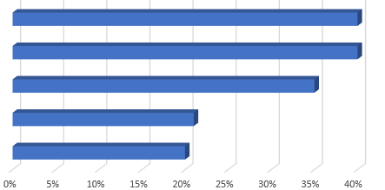
European patent strategy post-grant
  28% overall uptake of Unitary Patent from patents granting in 2025
  40% uptake from European patentees
  Overall uptake rate varies across technology sectors
    Pharma 40%
    Biotech 40%
    Medtech 35%
    Computer tech 21%
    Telecoms 20%

Slide 56


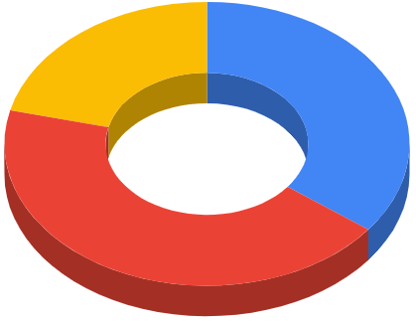
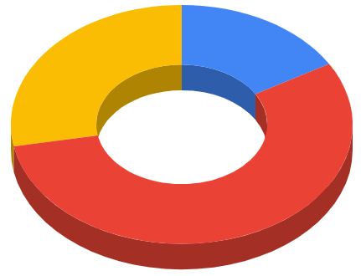




Validation and opt-out strategies
No opposition
Opposed (“high value”)
Notes:
Important to note that the strategy is implemented (usually) before any opposition is filed against the patent. However, opposition against patents aligns with higher value – opponents typically oppose to avoid litigation for infringement.
View the right-hand chart as strategy associated with higher-value patents likely to be litigated. Far fewer of these are validated and not opted out – most are opted out, and high uptake of UP.
On left chart – 35% left to the default validation + left in the UPC, as potential lowest cost option.
Most popular choice by far is to opt out of UPC still.

Slide 57



UPC decisions
UPC infringement actions
UPC revocation actions
Notes:
Most infringement actions have resulted in success.
Most revocations have ultimately failed to revoke.
Court seems patentee-friendly.

Slide 58
Inventive step assessment at the UPC

Slide 59
Inventive step at the UPC
The Boards of Appeal at the EPO assess inventive step under the “problem and solution” approach
  Identify the closest piece of prior art
  Identify the objective technical problem by comparing the claim under examination to the closest piece of prior art, and
  Determine whether the skilled person, on looking to solve the objective technical problem, would be incited by the teaching of the prior art to arrive at the claimed subject matter

Slide 60
Inventive step at the UPC
On 25 November 2025, the Court of Appeal of the UPC handed down its decision on a dispute between Amgen Inc. and Sanofi and Regeneron Pharmaceuticals Inc.
This is the first UPC Court of Appeal decision to comment on the legal test to be applied in assessing whether the subject matter of a claim is inventive
In summary, on applying inventive step before the UPC, you must:
  Identify the object of the patent, i.e. the objective problem, by looking at the subject matter of a claim as a whole and determine what problem it purports to solve based on the disclosure in the patent, including the technical data in the patent
  Identify at least one realistic starting point, i.e., the closest piece of prior art, and
  Determine whether, on starting from the realistic starting point, the skilled person would be pointed or motivated to move in the direction of the claimed subject matter

Slide 61
Inventive step at the UPC
This new test involves looking from the perspective of the skilled person at the disclosure of the patent, at its priority date, to assess an objective problem that the patent aims to solve
Under the EPO’s problem and solution approach, the closest prior art is identified first
  “closest” based on functionality, or overlap of feature-set
The “objective technical problem” is then based specifically on that closest prior art:
  analysis of the novel features, and
  determining a technical problem associated with the prior art lacking those features

Slide 62
Inventive step at the UPC
It is likely that in most cases the EPO and UPC approaches will arrive at the same outcome
However, it is odd that the UPC Court of Appeal has chosen to diverge from long-established EPO test given that a primary purpose of the UPC is to “enhance legal certainty”
We may see different outcomes where the closest prior art under the EPO’s approach is selected based on a strong overlap of feature set, rather than on similarity of purpose
Where close prior art is found during prosecution, the specification may not teach an invention centred on the features providing novelty – in those cases the outcomes might differ
Too early to predict how the courts may apply this test – watch this space!

Slide 63
A doctrine of equivalents at the UPC – a weapon in the patentee’s arsenal

Slide 64
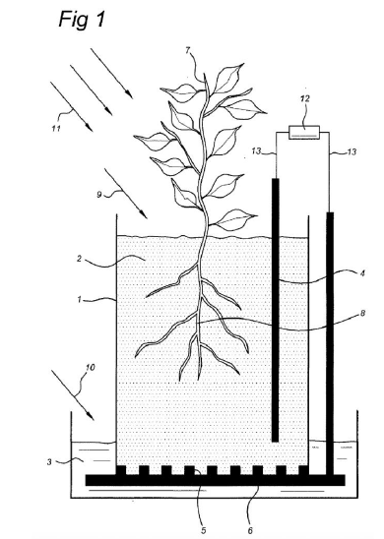
UPC doctrine of equivalents
  Plant-e v Bioo – Plant-based-Microbial Fuel Cell (P-MFC)
  Patent directed to a method for converting light energy into electrical energy and/or hydrogen
  Uses a reactor having an anode compartment and a cathode compartment
    The anode compartment including a microorganism capable of oxidizing an electron donor compound, and
    A living plant (or part of a plant) capable of converting light energy into the electron donor compound
    Wherein the microorganism lives around the root zone of the plant

Slide 65
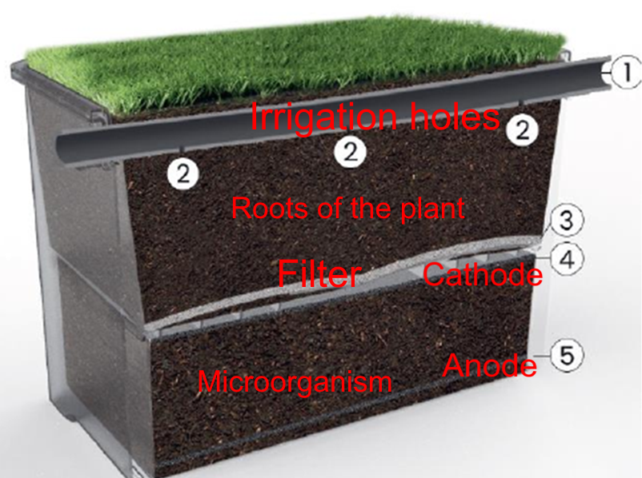
UPC doctrine of equivalents
  Considering the alleged infringement, certain features were found not to be present:
    The anode compartment comprising a living plant (or part of a plant) capable of converting light energy into the electron donor compound
    Wherein the microorganism lives around the root zone of the plant.
  Instead, the anode/cathode and microorganism are provided in a separate chamber from the plant
  Otherwise, the cell functions to the same principles

Slide 66
UPC doctrine of equivalents
  A variant is equivalent to an element specified in the claim if the following four points are satisfied:
  Technical equivalence: does the variation solve (essentially) the same problem that the patented invention solves and perform (essentially) the same function in this context?
  Fair protection for patentee: Is extending the protection of the claim to the equivalent proportionate to a fair protection for the patentee?
  Reasonable legal certainty for third parties: does the skilled person understand from the patent that the scope of the invention is broader than what is claimed literally?
  Is the allegedly infringing product novel and inventive over the prior art?

Slide 67
Post-grant strategy
Summary

Slide 68
Post-grant summary
UPC is developing in a way that appears favorable to patentees
  Doctrine of equivalents provides a broad scope
Unitary patent provides a good value option for covering many territories for a short term
  Becomes expensive with large renewals in the long term
  No ability with the UP to shed validations to reduce the cost over time
Traditional validations are still the most cost-effective post-grant option to cover a small set of key territories – UK, Germany, France, for example
  Particularly since the UK is not part of the UP coverage
No disadvantage to opting out of the UPC jurisdiction since the applicant has the ability to opt back in to make use of the UPC

Slide 69

npalmer@forresters-ip.com

Slide 70

Any questions?

